Slide 1
OC ACM Executive Committee
Format: | Online via Zoom
Zoom Link: | https://acm-org.zoom.us/j/93004927026?pwd=NWRGR0RObUJWZFk5N0NjdFdBMUxEdz09
Date: | June 26, 2024
Call to order 12:11

Slide 2
Agenda
Review of prior meeting minutes
Officers / Volunteers
Treasurer’s Report
July Event Preparation
Future Event Planning
Committee Business

Slide 3
Meeting Attendees
Michael Fahy
Allen Takatsuka
Dan Whelan
Marc Velasco
Nilo Niccolai
Winsor Brown
Ansel Teng
Don Choi
Trae Palmer
Raman Rajan
Shirley Tseng
Cynthia Kirkeby
Farhad Mafie
Jared Miller
Kenneth Aguilar
Dawn Childs
Taylor Noh
Stephen Landaas

Slide 4
Motions
Motion | Moved By | Seconded By | Status
Approve May 2024 Executive Committee minutes | Michael | Farhad | Approved

Slide 5
Officers
Position | Volunteer
Chair | Daniel Whelan Ph.D.
Vice-Chair | Allen Takatsuka
Treasurer | Michael Fahy Ph.D.
Secretary | Marc Velasco
Communications | Dawn Childs
Webmaster | Stephen Landaas
SIGAI-OC Liaison | Ansel Teng Ph.D.
Membership Chair | Farhad Mafie

Slide 6
Officers (cont’d)
Position | Volunteer
University Liaison | Michael Fahy Ph.D., Stephen Landaas
Program Speaker Coordinators | Raman Rajan, Farhad Mafie, Taylor Noh
Program Video Coordinator | Trae Palmer
Social Media Committee | Don Choi, Cynthia Kirkeby, Trae Palmer
Membership Committee | Open
Hospitality | Taylor Noh
Fundraising Coordinator | Jared Miller
Members at Large | A. Winsor Brown, Shirley Tseng, Nilo Niccolai Ph.D.

Slide 7
Treasurer’s Report EOM May 2024
Beginning Balance | $6,976.28 | 4/30/24
Deposits | $731.00 | 5/6 From Benevity
Expense | $12.00 | 5/1 for Google gSuite_oc-acm.org
Current Balance | $7,695.28 | 4/18/24
Restricted Funds | $2,964.20 | IBM Grant
Unrestricted Balance | $4,731.08 | 5/31/24
Deposit from Benevity, could have been combined from multiple sources.
Gsuite = domain reservation renewal

Slide 8
July 17th Event Preparation
Bill Gervasi will be speaking on “Averting a System and Software Induced Energy Crisis”
I’ll send out invites to a pre-meeting social hour at SOL Mexican Cocina starting at 5 PM. It’ll be great if many of you can join us for the Happy Hour.
Current attendee count is:
Any special promotion or venue prep that we need to do for this meeting?
Small # of registrations, will benefit from promotions, will send out invites
First comms will go out in few weeks
Self-promotion from excomm will help
Can we tie promotions to related articles? Will send out suggested articles

Slide 9
Future Event Planning

Slide 10
Next Program Event Planning
Date | Speaker | Talk
3/19/2025
1/15/2025
11/20/2024
9/18/2024 | Bala Chidambaram Chief Engineer, Boeing Autonomy | Airspace Autonomy
7/17/2024 | Bill Gervasi | Averting a System and Software Induced Energy Crisis
5/16/2024 | Prof. Shawn X. Wang | Understanding Life via Computational Bioinformatics
3/20/2024 | Prof Marco Levoralo, Associate Professor, UCI | Reliable Real-Time Distributed AI for Mobile Autonomous Systems
1/17/2024 | Josh Lindstrom, Managing Director of Data Intelligence at Trace 3 | AI supercomputer for the Orange County Community

Slide 11
Meeting Topics
Recent Meetings
Future Meetings
Artificial Intelligence
  Distributed Systems
  Community Supercomputer
  Programming
  LLMs
  Regulating AI
  Deep Fakes
  Deep Learning Hardware
Bitcoin, Smart Contracts, NFTs
Natural Language Analysis
Global-Scale Edge Computing
Robotics
Computational Bioinformatics
Memory System Performance
What other topics should we focus on this year?
  Quantum Computing
  Internet of Things (IoT)
  Computer Networking
  Cyber Security
  Robotics (Drone Swarms)
Industry and Academia Perspectives

Slide 12
OC Tech Companies
https://tms-outsource.com/blog/posts/tech-companies-in-orange-county/
Do any of us have contacts at these or other companies that we could approach either to ask to speak or to nominate potential speakers?

Slide 13
Member Poll Questions
Following up on our discussion last month, I’ll work with Dawn to circulate a poll asking:
  Which computing related topics would you be interested in?
  Would you like to suggest a speaker?
  Would you like to suggest an organization that we should contact?
  Are you willing to make an introduction for us?
BTW, these questions are in our current registration form.
Feedback from three May meeting attendees:
  LLM applications and Real-world use cases
  IOT
  AI
  Cybersecurity discussion around the current attack approaches
  IP law update

Slide 14
Future Speakers – Follow-up
Updates from May:
Dan and Farhad spoke with Bala Chidambaram whom Dr Marco Levorato introduced him to. Bala is the Executive Director, Autonomous and AI-Enabled Systems at Boeing Autonomy and has volunteered to speak at our September meeting
No response to date from Louis Ehwerhemuepha, Director, Computational Research at CHOC.
Taylor has future meeting candidate for speaker
Should we cross promote next talk with LA area given aerospace ties, LA has mostly been siggraph events, although speaker is out of long beach area so might be good opportunity

Slide 15
Bala Chidambaram - Airspace Autonomy
Abstract - The airspace industry has witnessed significant interest/activity in the use of autonomous solutions, across military and commercial applications. Driven by safety, efficiency and performance, and capability extension, these span a wide range, from Urban Air Mobility, to Cargo Operations, to military ISR missions, to Search and Rescue. There are many challenges to widespread adoption including technical, regulatory and societal (acceptance) considerations. This talk describes some of the key technical challenges in airspace autonomy, e.g., (airborne) conflict detection and resolution, contingency management, verification, and validation approaches, etc. The talk also surveys ongoing work in industry in addressing these challenges, including vehicle platforms currently under development. The focus is on the algorithmic and software aspects - as an example, the use of Partially Observable Markov Decision Processes, in the development of conflict detection and resolution solutions, now codified in RTCA standards. On a related note, while Deep Learning has been widely adopted in automobile autonomy, challenges relating to vehicle certification limits its usage to safety-critical airspace applications. The challenges and opportunities here are also discussed. Finally, the talk touches upon the regulatory landscape and the work being done in the FAA and EASA towards enabling an autonomous airspace future.

Slide 16
Bio - Bala Chidambaram is the Executive Director and Chief Engineer of Autonomy in the CTO’s Office at Boeing. In this role, he is responsible for defining and executing Boeing’s autonomy strategy across a variety of commercial and military programs. In his 25 year career at Boeing, Bala has held leadership roles in several areas, including modeling and simulation, electro-hydraulic actuation systems, software standards for vehicle health management, and secure connectivity solutions. His teams have supported platforms including the C-17 Globemaster III, the CH-47 Chinook, the V-22 Osprey, the International Space Station, the 787 Dreamliner, the 777X, and various Unmanned Vehicles. Bala has a Bachelor's degree in Engineering from the Indian Institute of Technology, Madras, a Ph.D. in Engineering from the University of California at Berkeley.

Slide 17
Peter Chang, MD (UCI)
Dan was able to have a phone call with Dr. Peter Chang.
He seemed interested in speaking but follow-up communications have been a challenge. I’ll continue to work to sign him up as a speaker.
Here’s some biographical info:
Peter D. Chang, MD joined the University of California, Irvine in July 2018. He currently serves as the Associate Professor for the Departments of Radiological Sciences and Computer Science. Additionally, he is the Co-Director for the Center for Artificial Intelligence in Diagnostic Medicine (CAIDM), a multi-specialty initiative to develop and integrate artificial intelligence technology across the UC Irvine healthcare system.
He is also a co-founder of multiple AI startups including most recently Avicenna.ai, a company focused on deep learning for medical imaging. Dr. Chang’s unique perspective arises from experience both as a radiologist physician and software engineer with expertise in developing deep learning algorithms, working closely with many industry partners including Nvidia, Amazon and Canon Medical. His work has led to numerous abstracts, manuscripts, five best conference paper awards, two patents/copyrights, and top finishes in various competitions including the international 2016 MICCAI challenge. He is currently a member of national AI steering committees for the RSNA, ASNR, SIIM and ACR.

Slide 18
Dave Cunningham (Akamai)
Raman is pursuing an opportunity:
He met someone at Akamai enterprise security services and was discussing how AI has impacted volume and nature of attacks. I asked if they can provide a researcher or engineer to talk about it. They were open to that.
A month or so back I attended a chapter meeting at SCORE where a guy who runs a ransom ware recovery business spoke about how he grew his business. I found the ecosystem of disparate services (negotiating with attackers, bitcoin camouflaging, government lobbying, system recovery etc.) that need to be engaged when a ransomware attack takes down an institution very interesting. We can approach him for a more technical talk.

Slide 19
Future Program Event Candidates (UCI)
Machine Learning
Stephan Mandt (anomaly detection without supervised learning)
Roy Fox (reinforcement learning, robotics)
Jing Zhang (ML applied to bioinformatics)
Alex Berg (computational visual recognition, starts @UCI Spring 2022)
Dr. Peter Chang (AI and Medicine)
Control Theory & Robotics
Magnus Egerstedt, Dean of Engineering, Samueli School of Engineering
(Referred by Aaron Ames of Caltech)
System
Sang-Woo Jun (acceleration)
Sangeetha Jyothi (Data center networking)
Moshen Imani (bio-inspired computing)
Theory
Vijay Vazirani (involved with the design of early Google Ad Placement Alg.)
Informatics
Vladimir Minin (Data analysis wrt infectious diseases)
Stacy Branham (human-centered computing)

Slide 20
Meeting Venue Update
No update yet from Knobbe regarding how long we can continue to use their facility
Farhad introduced me to Annalicia Anaya of LearningFuze. I spoke with her and briefed her on our chapter and I encouraged her to promote our events to their students who are working on developing programming and data analytics skills.
We may be able to use a meeting space at their facility should Knobbe not be able to assist us at some point.
There facility is located further south and as such isn’t ideal from a geographic perspective. We’ve been meeting in central OC since our inception and have attendees from across the county.
That said, it’s great to have another option.
Meeting space size looks good, 70-90 with chairs

Slide 21
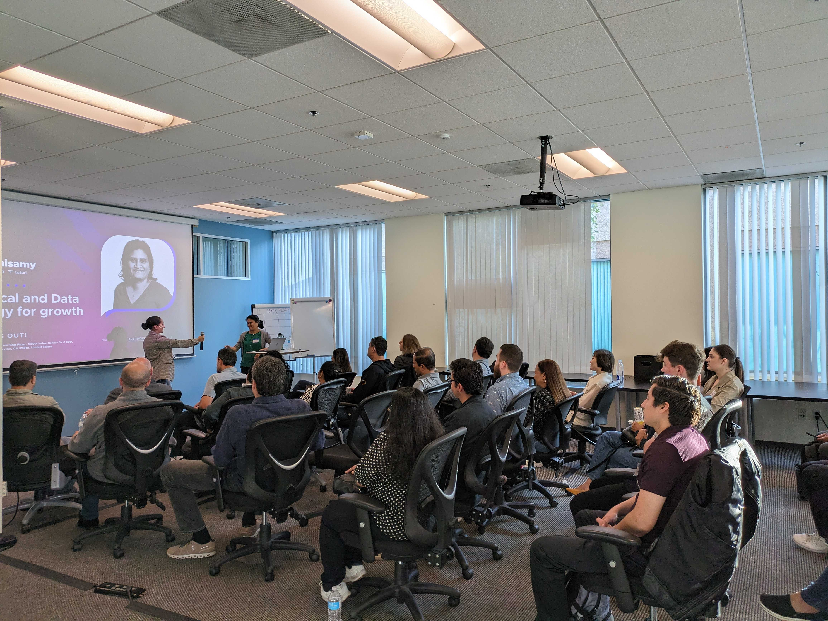
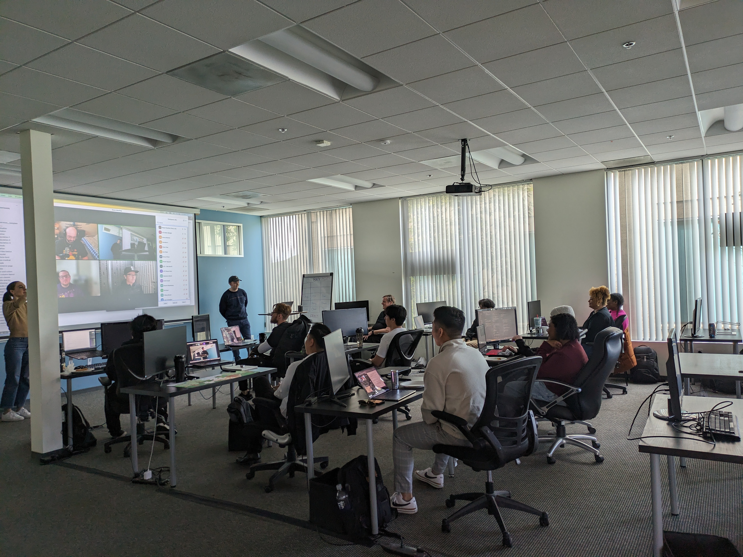
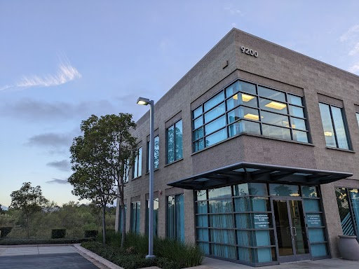
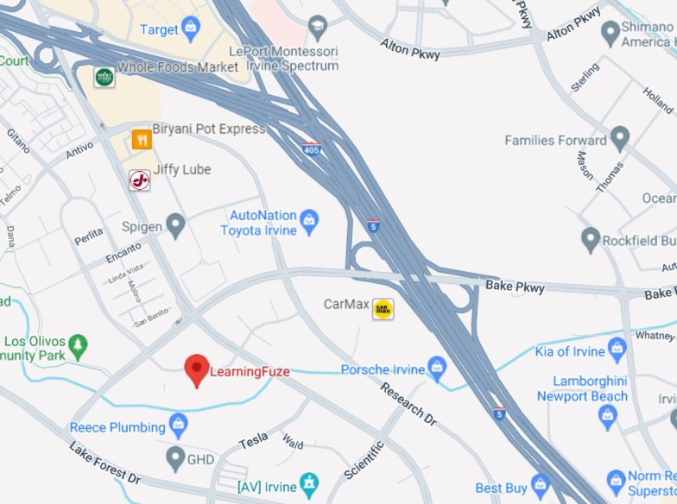
LearningFuze Site Photos

Slide 22
Future Program Event Candidates
Potential Speakers - In no prioritized or feasibility order
Prof Ali Hessami (UK)
Caltech Professor Yisong Yue, ML [Dan]
Andrew Kirkland, CISO at Starbucks
Beth Harnick-Shapiro [Marc]
Bill Lobig VP IBM Software Development - Analytics [Marc]
Christophe Begue, IBM - Blockchain (Mike Marin will research if he is indeed at IBM)
John Koon, Tech Idea Research - Autonomous Cars
Bill Cleveland – Data Visualization (M. Fahy has reached out to him)
Alanna Gombert, Global CRO at MetaX – Blockchain
Sushant Rao - Operational Analytic Data Stores (M. Fahy has reached out to him)
Paul Anderson, Anderson Software Group – Go language
Alyssa Columbus, Data Scientist at Pacific Life - Robust and Reproducible Predictive Modeling Workflows
Dianne Cook, Prof. of Business Analytics, Monash University – Data Visualization
Topics
Interest in potentially having a future talk focused on Privacy By Design and related best practices identified in March meeting

Slide 23
Committee Business
Volunteer Updates
New/Other Business
Michael – student awards, should we just give sw engineering and computer science awards from ACM only? Yes no objection from IEEE (Winsor)
Trae – will remove link for last program video from YouTube main page, leave uploaded
Trae – do we want a presence on bluesky? Will look into it more, linkedin is the most popular, probably not spend effort here just yet
Adjourn 12:43pm

